Slide 1

FROM France to germany: AIRBNB TRENDS THROUGH THE DATA LENS
PRIYA SHANMUGAM
ROHAN ashok gonabal
K. BRINDHA
S. YUVARAJ
Batch Code: DA464S46
Project Guide: Komilla Bhatia

Slide 2
Problem Statement
This project analyzes Airbnb data from France and Germany to identify key factors influencing user satisfaction and booking behavior. Insights help improve pricing strategy, amenity offerings, and host performance for better customer engagement and increased bookings.
objectives
Understand Host Landscape
Pricing Optimization
Amenities Impact
Review & Rating Insights
Statistical & Hypothetical Analysis
Policy & Cancellation Trends
Market Composition & Availability
Geo-Spatial Trends

Slide 3
Data description
France:
56,562 rows × 32 columns
Germany:
604 rows × 32 columns
Final Data:
57,155 rows × 81 columns
Host information
Review scores and amenities
Rental prices and cancelation policies
Listing details (room type, property type)
Location (country, state, city)

Slide 4
TOOLS AND TECHNIQUES USED
Tools:
Python (Pandas, NumPy, Matplotlib, Seaborn)
Jupyter Notebook for development & exploration
Tableau for visualization &
Microsoft Power Point for presentation
Techniques:
Data Cleaning
Feature Engineering
Exploratory Data Analysis (EDA
Visualization
Outlier Treatment
Missing Value Imputation
Descriptive Statistics

Slide 5
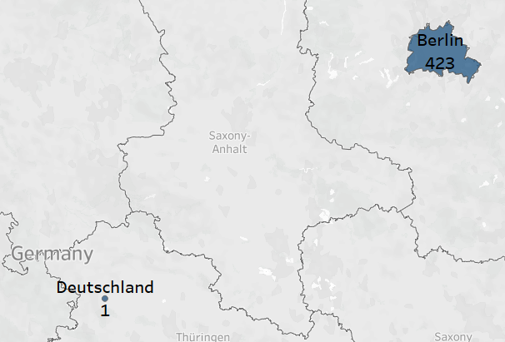
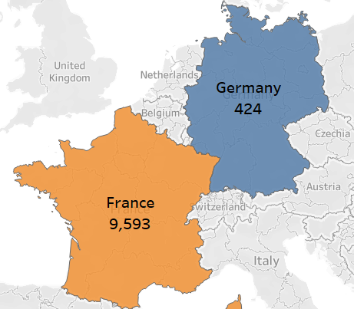
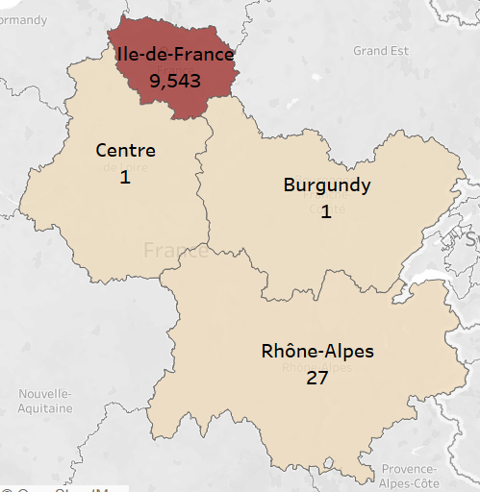
State-wise hosts Distribution
Ile-de-France has more than 99% of hosts in France
All, except for 1, hosts are in Berlin State of Germany

Slide 6
Room Type Distribution by Country
Total No. Of Hosts
48,896
Hosts in France
48,323
Entire Room/Apt.
48,539
Private Room
7435
Hosts in Germany
573
Entire Room/Apt.
283
Shared Room
577
Private Rooms
312
Shared Room
9

Slide 7
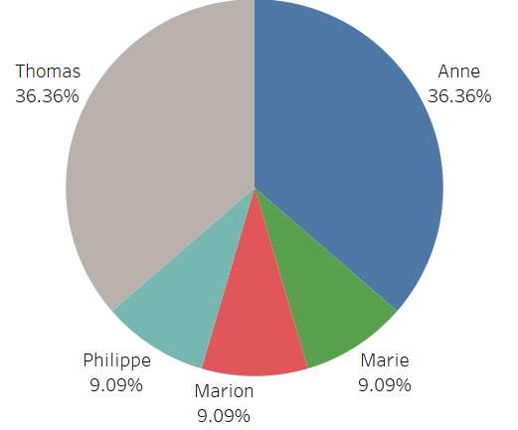
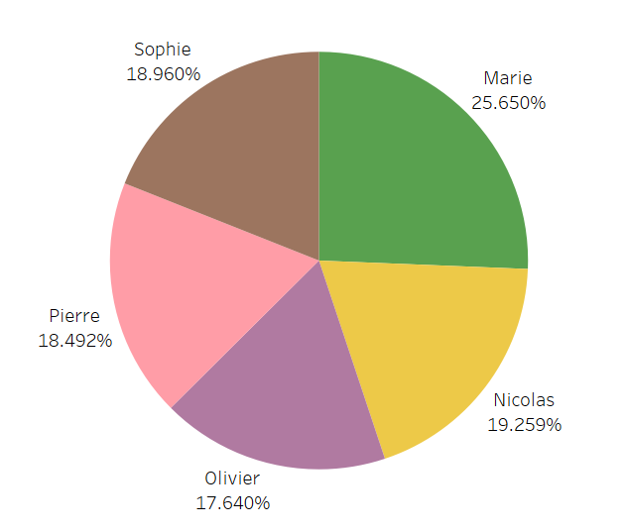
Top 5 Hosts with Maximum Property Count
Germany
France
Thomas & Anne holds Maximum Property in Germany
Marie Holds Maximum Property in France

Slide 8
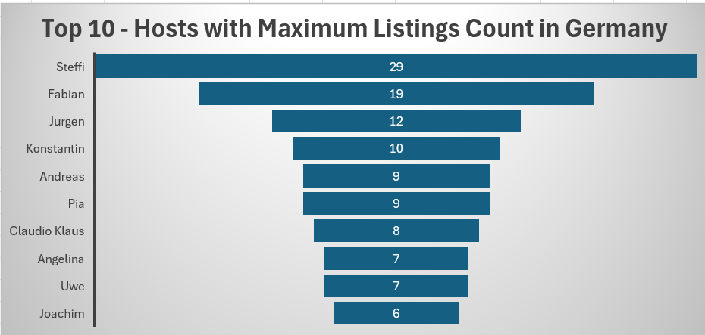
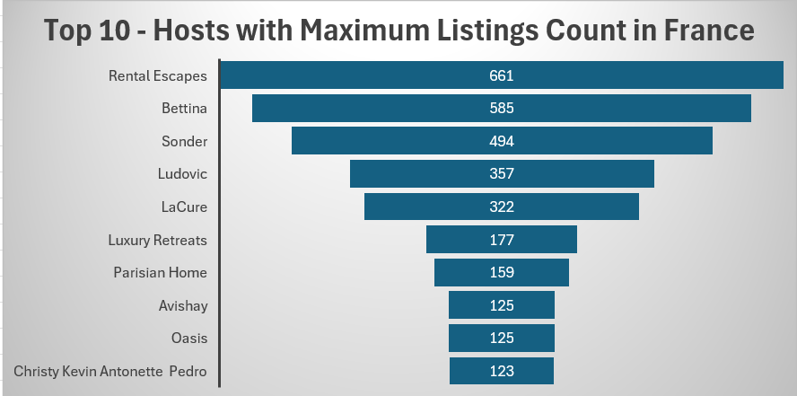
Top 5 Hosts with maximum listings count
Germany
France
Steffi Holds 29 Listings in Germany
Rental Express Holds 661 Listings in France
France has more commercial or large-scale hosting.
Germany shows signs of smaller, possibly individual host activity.

Slide 9
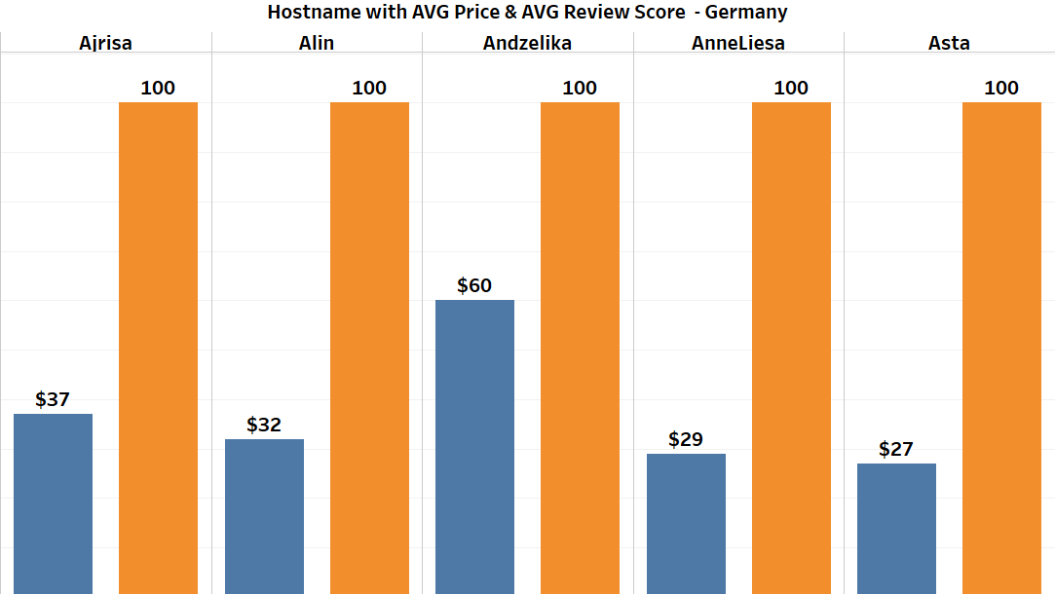
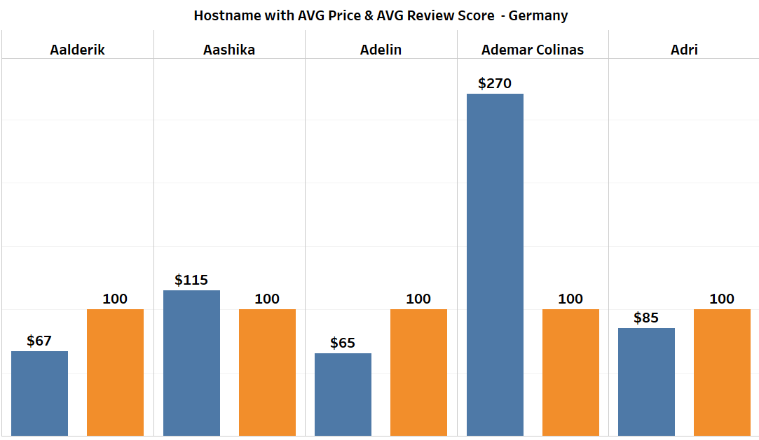

Host Performance: Rating & Cost
Germany
France
Top hosts in both countries have perfect scores
but rental costs in France are nearly 70% higher than in Germany.

Slide 10
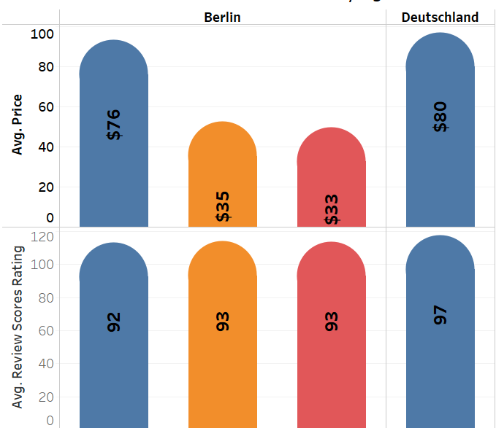
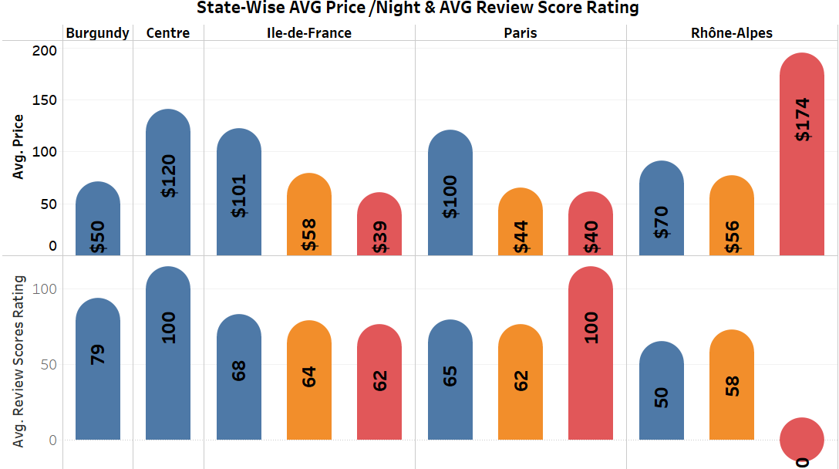
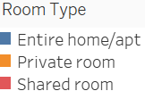
State & Room Type: Ratings vs Price
Germany
France
Germany provides more affordable rentals with consistently higher and stable review scores across all states and room types.
Entire Home/Apt listings are available in all states, commanding the highest prices and best ratings in both countries.

Slide 11
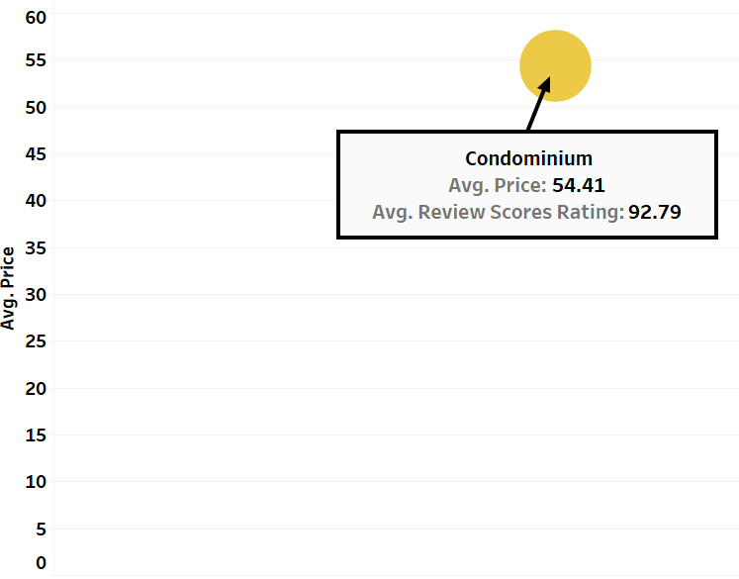
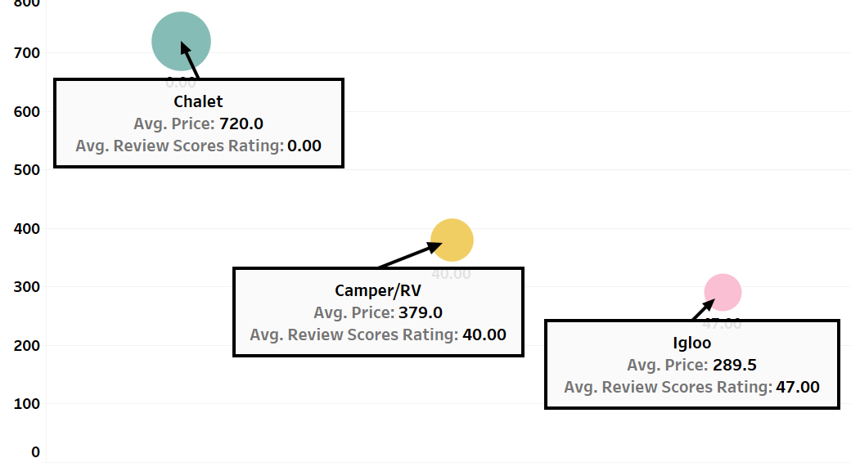
Average Price & Review Score by Property Type
Germany
France
Chalet Property Type in France is the Most Expensive one but with Zero Rating
Only one Property Type in Germany Condominium – with Least Price and Best Rating

Slide 12
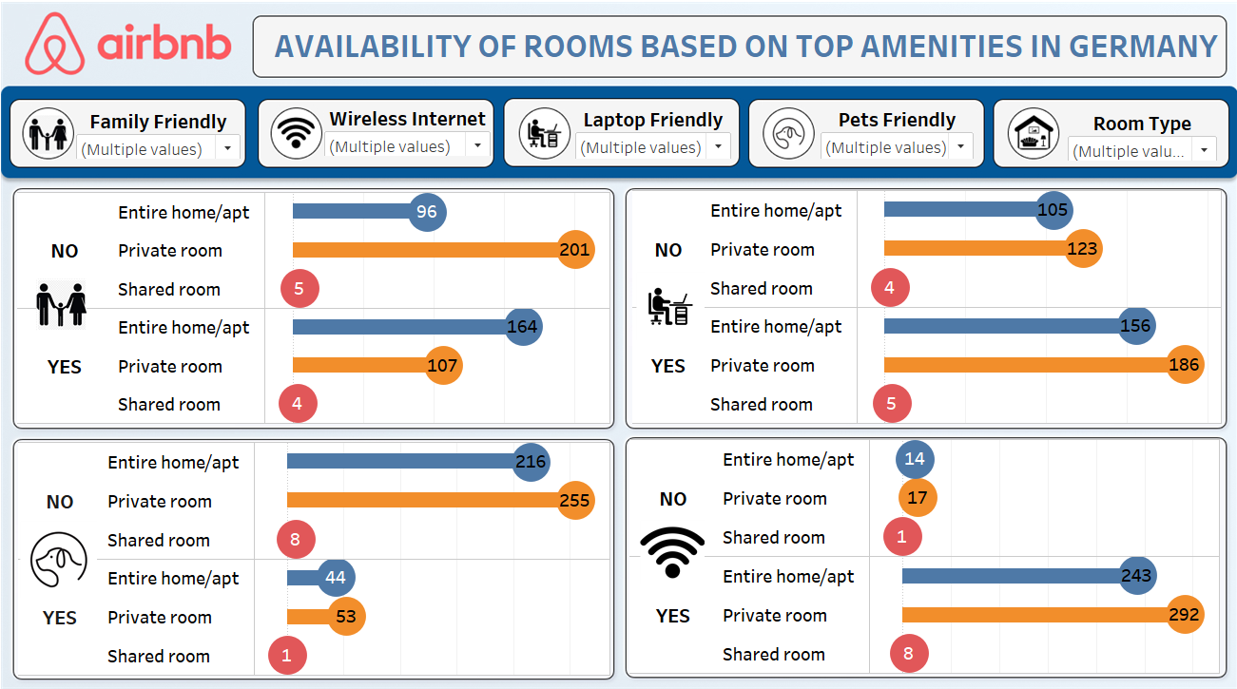

Slide 13
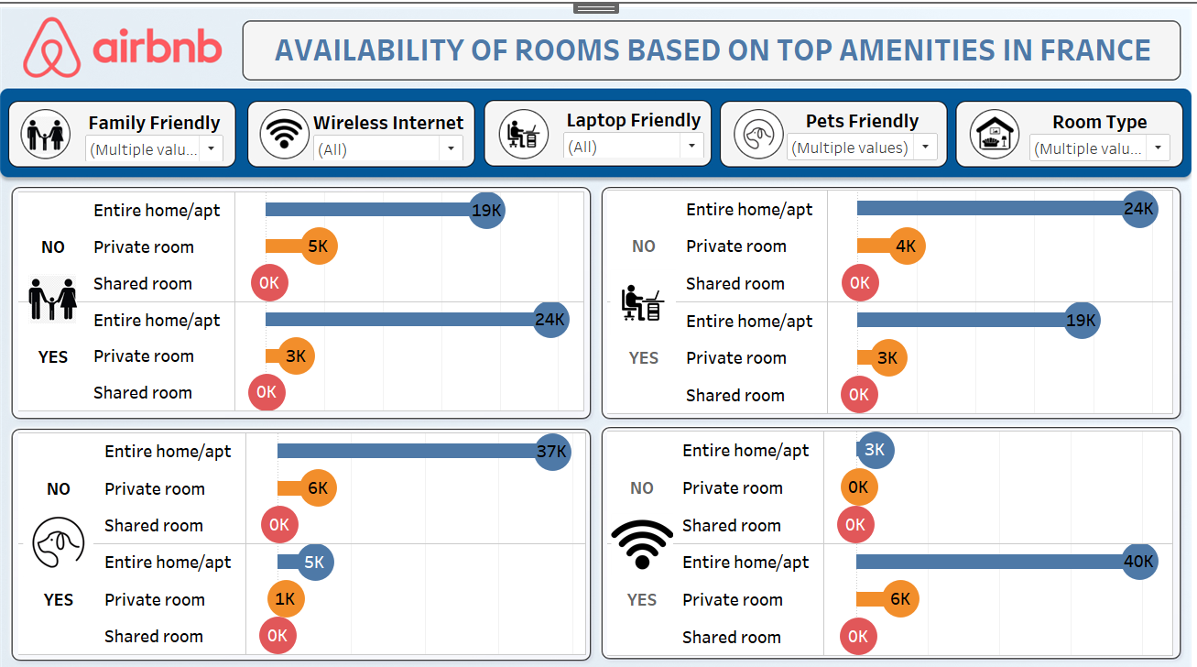

Slide 14
Review Scores By Cancelation Policy
Germany
France
Moderate & Strict Policies are appreciated than the Flexible or Strict Policies in both the Countries

Slide 15
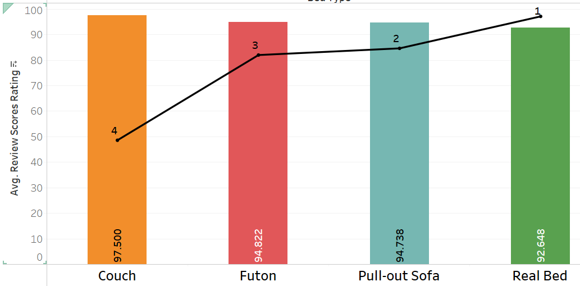
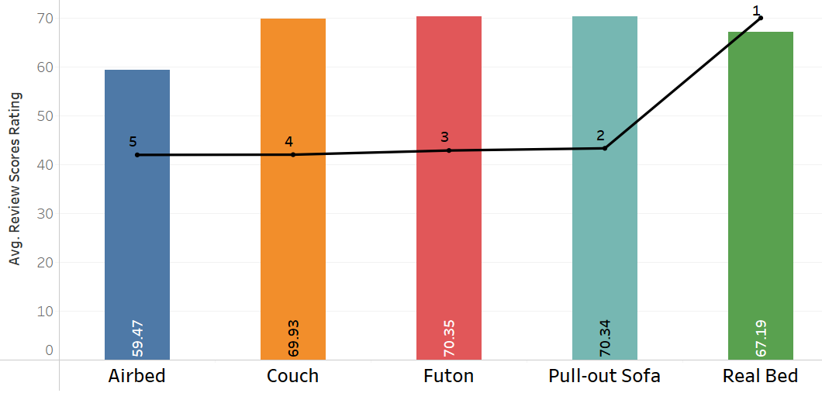
Ranked by price – bed types
Germany
France
Real Beds are costlier in both the countries with Good Rating Score.
Couches are cheap but has got better reviews.

Slide 16
Key Feature Probabilities Across Countries
Family-Friendly with more than 3 Beds
Germany: 85%
France: 91%
WiFi - availabilty
Germany: 95%
France: 94%
Experience > 10yrs &
Response Rate > 90
Germany: 27%
France: 54%
No. of Reviews > 10 &
Avg. Rating Score > 90
Germany: 18%
France: 22%
Laptop Friendly – Private Rooms
Germany: 60%
France: 39%
Pet-Friendly
Germany: 17%
France: 12%

Slide 17
Hypothesis Test: Comparing Amenities in France vs Germany
Claim: There is no significant difference in the number of amenities offered by Airbnb listings in France and Germany.
Sample Details:
20% random sample from both the countries
Population Mean: • France: 12.63 • Germany: 12.38
Sample Mean: • France: 13.18 • Germany: 12.22
Test Statistics:
Z-statistic = 0.54
Z-critical = ±1.96
P-value = 0.5914
Conclusion: We arrived at a Statistical Evidence to accept our claim that there is no significant difference in amenities offered by Airbnb listings in France and Germany.

Slide 18
Machine Learning Models & Performance Summary
ML MODEL | MODEL PERFORMANCE | HOW IT HELPS THE BUSINESS
Price Prediction (Linear Regression) | Explains about half of the price variation. | Guides in setting competitive and fair prices for properties.
Family-Friendly Prediction (Logistic Regression) | 72% accurate with a strong prediction score. | Helps identify and promote family-friendly homes to the right audience.
Price Segmentation (KMeans Clustering) | Clearly groups properties into High, Medium, and Low price ranges. | Enables better pricing strategies and targeted promotions.
Price Prediction (KNN Regressor) | Delivers reliable price forecasts. | Supports price planning for new and existing listings.
Room Type Classification (KNN Classifier) | 87% accurate in predicting room types. | Ensures clear property categorization, improving customer experience.

Slide 19

Tip For Travelers to France
Book Early in Paris:
Île-de-France is highly competitive. Tip: Book in advance for better prices and top-rated stays.
Choose Entire Apartments:
Most listings are full homes—ideal for couples or families. Tip: Best for privacy and full amenities.
Review High-Priced Listings Carefully:
Price doesn’t guarantee quality. Tip: Prioritize listings with review scores of 80+.
Go for Real Beds:
Guests rate these better. Tip: Avoid sofa beds—check bed type before booking.
Skip Shared Rooms:
Rare and poorly rated. Tip: Opt for private rooms or entire places for a better stay.

Slide 20

Tip For Travelers to Germany
Explore Beyond Big Cities:
Listings are well spread across regions. Tip: Try smaller towns for unique, peaceful stays.
Private Rooms Are a Great Option:
Common, well-equipped, and budget-friendly. Tip: A solid choice for solo travelers or short stays.
Look for Work-Friendly Amenities:
Many listings cater to remote workers. Tip: Filter for Wi-Fi and laptop-friendly spaces.
Pet & Family-Friendly Listings Available:
More inclusive than in France. Tip: Use filters if traveling with kids or pets.
Check Bed Type & Amenities:
Shared rooms may lack essentials. Tip: Confirm bed quality and must-have features before booking.

Slide 21


Paris Leads, But Gaps Remain:
Action: Enhance listing quality and service.
Entire Homes Dominate:
Action: Promote full-property hosting with top amenities.
Growth in Underused Regions:
Action: Target these areas with marketing.
Niche Stays = High Returns:
Action: Highlight unique stays in campaigns.

Slide 22

Balanced Market:
Action: Attract new and budget-friendly hosts.
Varied Room Types:
Action: Use flexible pricing and property strategies.
Amenities Drive Bookings:
Action: Target digital nomads.
Inclusive Listings Stand Out:
Action: Promote inclusive features to widen reach.

Slide 23

Thank you !!!

